Slide 1
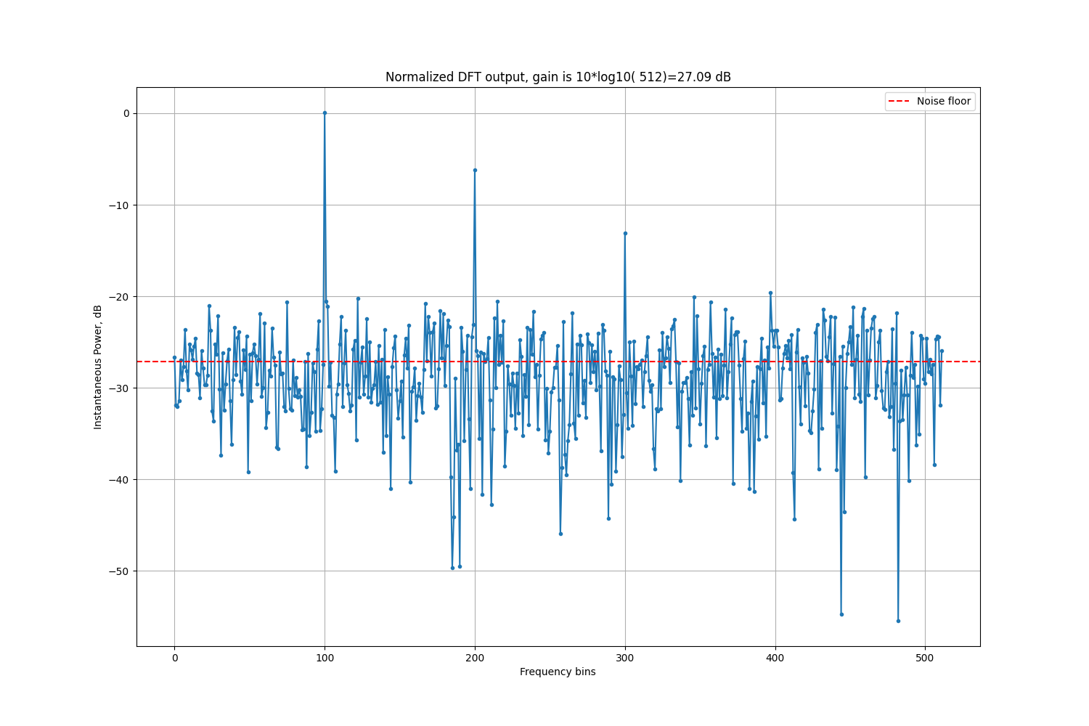
The Advanced Engineering Course
Primary Radar Signal Processing
DFT Signal Gain derivation with modelling in Python
Aleksei Rostov, PhD,
Senior R&D Engineer,
FPGA/Embedded Linux Developer,
aleksei.rostov@protonmail.com

Slide 2


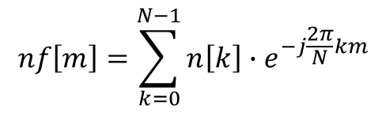




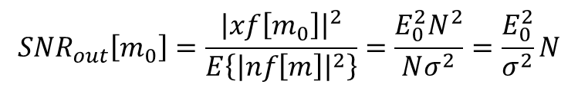
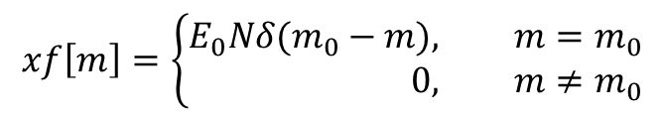

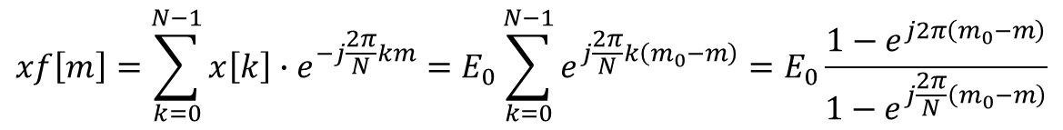

$$x\left[k\right]$$
$$xf\left[m\right]$$
$$x\left[k\right]−input complex signal, k=0…N−1$$
DFT
$$n\left[k\right]−input complex white noise$$
$$n\left[k\right]$$
$$nf\left[m\right]$$
$$xf\left[m\right]=\sum_{k=0}^{N−1}{x\left[k\right]∙e^{−j\frac{2π}{N}km}}=E_{0}\sum_{k=0}^{N−1}{e^{j\frac{2π}{N}k\left(m_{0}−m\right)}}=E_{0}\frac{1−e^{j2π\left(m_{0}−m\right)}}{1−e^{j\frac{2π}{N}\left(m_{0}−m\right)}}$$
$$x\left[k\right]=E_{0}e^{j\frac{2π}{N}km_{0}}$$
$$xf\left[m\right]=\left\{\begin{aligned}E_{0}Nδ(m_{0}−m), &m=m_{0} \\ 0, &m≠m_{0}\end{aligned}\right.$$
$${\left|xf\left[m_{0}\right]\right|}^{2}=E_{0}^{2}N^{2}$$
$$nf\left[m\right]=\sum_{k=0}^{N−1}{n\left[k\right]∙e^{−j\frac{2π}{N}km}}$$
$$E\left\{{\left|nf\left[m\right]\right|}^{2}\right\}=E\left\{\sum_{k_{1}=0}^{N−1}{n\left[k_{1}\right]∙e^{j\frac{2π}{N}k_{1}m}}\sum_{k_{2}=0}^{N−1}{n\left[k_{2}\right]∙e^{−j\frac{2π}{N}k_{2}m}}\right\}=\sum_{k_{1}=0}^{N−1}{\sum_{k_{2}=0}^{N−1}{\left.E\{n[k_{1}]∙n[k_{2}\right]}}\}{∙e}^{j\frac{2π}{N}\left(k_{1}−k_{0}\right)m}$$
$$E\left\{{\left|nf\left[m\right]\right|}^{2}\right\}=Nσ^{2}$$
$${SNR}_{out}\left[m_{0}\right]=\frac{{\left|xf\left[m_{0}\right]\right|}^{2}}{E\left\{{\left|nf\left[m\right]\right|}^{2}\right\}}=\frac{E_{0}^{2}N^{2}}{Nσ^{2}}=\frac{E_{0}^{2}}{σ^{2}}N$$
$${SNR}_{in}=\frac{E_{0}^{2}}{σ^{2}}$$
aleksei.rostov@protonmail.com

